Slide 1


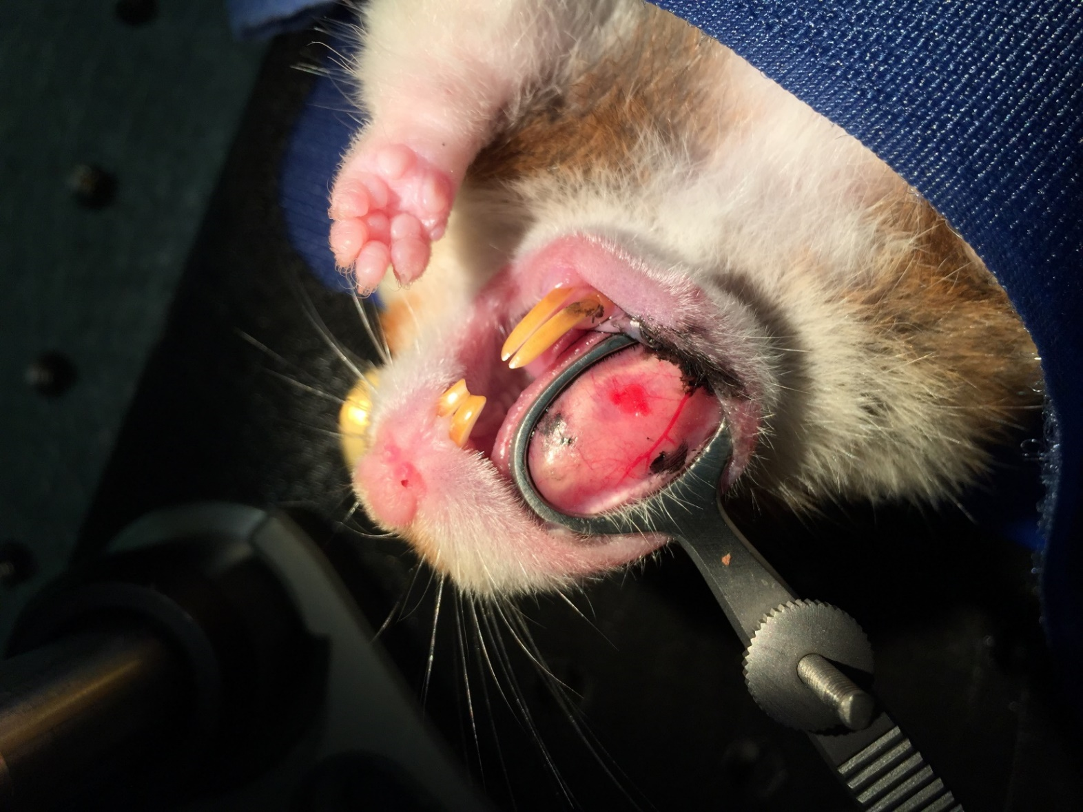
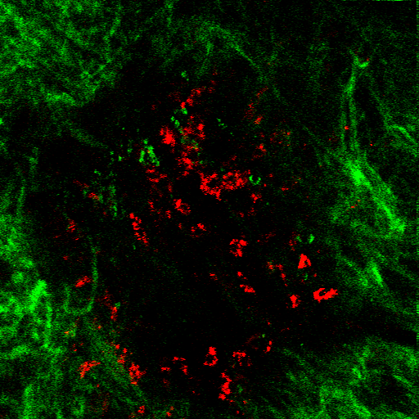
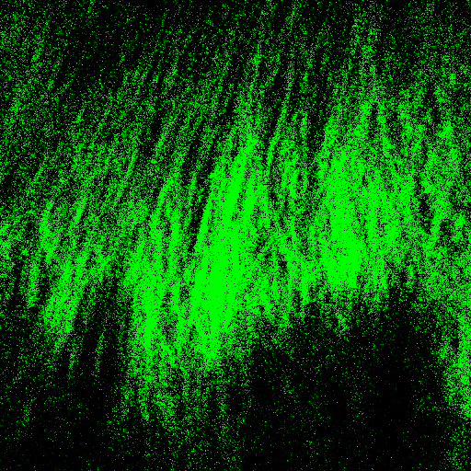

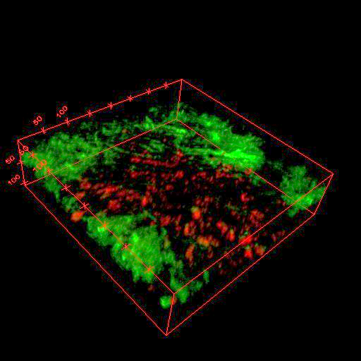
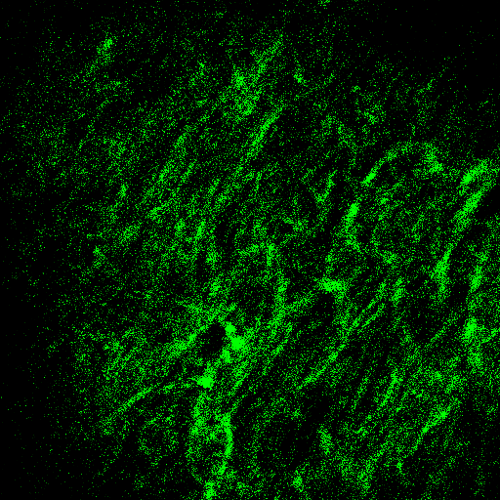
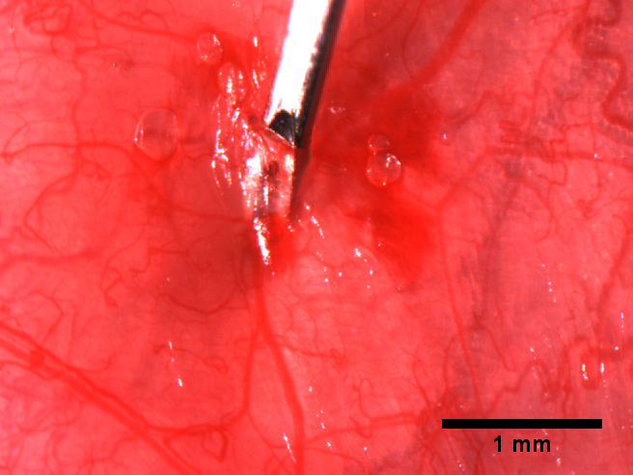
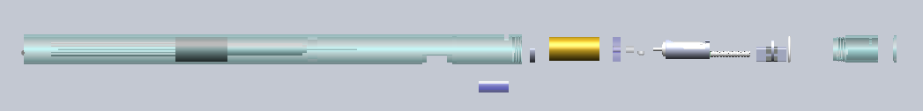
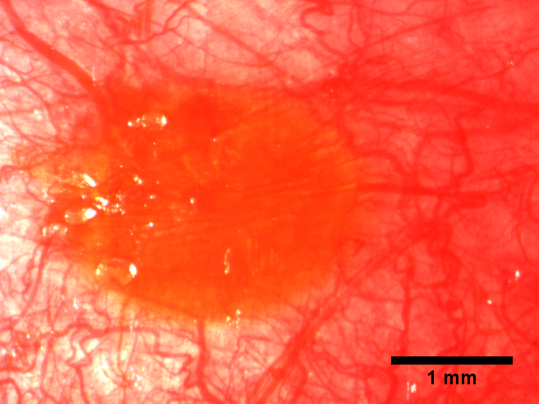
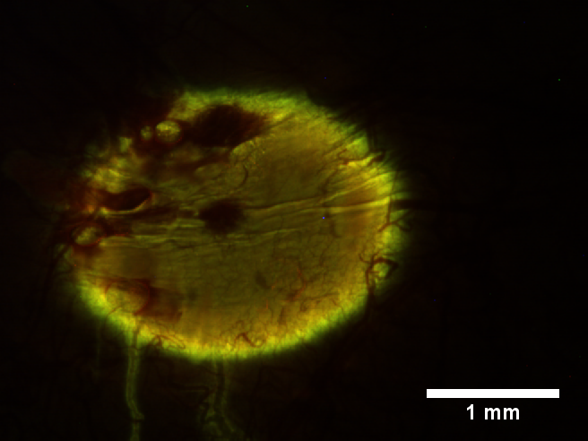

Ultrafast Laser Microsurgery Probe for Large Area Ablation
Arjun Rao¹, Kaushik Subramanyam², Ilan Gabay², Adela Ben-Yakar^{1,2†}
¹Department of Biomedical Engineering, The University of Texas at Austin, Austin, TX 78712;²Department of Mechanical Engineering, The University of Texas at Austin, Austin, TX 78712;
*Corresponding author: ben-yakar@mail.utexas.edu, Website: http://www.me.utexas.edu/ben-yakar/
Objective
III. In Vivo Hamster Testing
III. In Vivo Hamster Testing (cont.)
The objective of our project is to develop an ultrafast laser microsurgery probe to treat vocal fold scarring which can result from mechanical stress, overuse, or post-surgical healing.
Scarring of the vocal folds reduces mechanical compliance and can result in voice disorders. It is estimated that 4 million people in the US suffer from voice impairment due to vocal fold scarring, yet it lacks a reliable treatment¹.
One promising treatment involves the use of soft biomaterials aimed to restore viscoelasticity. However, in scarred vocal fold tissue, the increased tissue density causes the injection pressure to increase which hinders proper localization of the biomaterials, and decreases the effectiveness of the treatment.
Our proposed solution is to develop an endoscope capable of reducing the resistance of the tissue, by creating sub-epithelial voids through tissue ablation using ultra-short laser pulses^{2,3}.
Procedure
Hamster was injected with anesthesia
Right cheek was clamped and target zone was marked with tattoo ink
Cheek imaged at 30 microns, and ablated at 42 microns
2.0 mm x 0.4 mm void was created and then the hamster was moves to a micro injection setup
Nonlinear imaging 2 weeks postoperatively
To test performance of our system and to see if PRG was localized, we anesthetized hamster after 2 weeks and imaged.
Rhodamine b could easily be detected using two-photon imaging.
Collagen fiber were imaged using Second Harmonic Generation.
A
Hamster was moved to fluorescent setup
Injection contained PED, and rhodamine B.
Single Plane
Scarred
Injection of PEG to the ablated void.
The hamster cheek clamped
A close up view showing the ablation site with injected biomaterial
The needle piercing through the epithelium layer and injecting the biomaterial
A white light image of the void with injected biomaterial
(E) A fluorescent image of the biomaterial.
B
3D Rendering
Healthy
Ablation site
II. Probe Design
C
Red: Rhodamine b, Green: collagen
IV. Conclusions
Current design of probe. Adjustments to previous designs include advanced alignment system and spring to assist in return to ensure precision when returning to original position.
In parallel to probe design, in-vivo experiments in hamster cheeks are being performed to test our solution in vivo. The mechanical and biological properties of the hamster cheek most closely simulated the human vocal fold among common test animals and therefore hamsters were selected for this experiment.
Injection to the void
Collagen fibers seem normal without evidence of high density or directionality as seen in scarred collagen tissues.
We will test scarring methods on hamsters.
Scarring methods include electro-cautery and laser scarring.
D
E
V. References
White light image
Fluorescent image
S. Hirano, "Current treatment of vocal fold scarring," Curr Opin Otolaryngol Head Neck Surg 13(3), 143-147 (2005).
C. L. Hoy, W. N. Everett, M. Yildirim, J. Kobler, S. M. Zeitels and A. Ben-Yakar, "Towards endoscopic ultrafast laser microsurgery of vocal folds," J Biomed Opt 17(3), 038002 (2012).
Yildirim, M., O. Ferhanoglu, J. Kobler, S.M. Zeitels, and A. Ben-Yakar, “Parameters affecting ultrafast laser microsurgery of sub-epithelial voids for scar treatment in vocal folds,” Journal of Biomedical Optics, 18 (11), 118001 – 14 (2013)
Hoy, C.L., W.N. Everett, M. Yildirim, J. Kobler, S. M. Zeitels, and A. Ben-Yakar, “Towards endoscopic ultrafast laser microsurgery of vocal folds,” Journal of Biomedical Optics 17, 038002 (2012).
Hoy, C.L., O. Ferhanoglu, M. Yildirim, K.H. Kim, S.S. Karajanagi, K.M.C. Chan, J. Kobler, S.M. Zeitels, and A. Ben-Yakar, “Clinical ultrafast laser surgery: recent advances and future directions,” Invited Review Paper, IEEE Journal of Selected Topics in Quantum Electronics on Nanophotonics, in press (2014).

